Slide 1
C R E A T I V E L E A R N I N G + W E A R A B L E T E C H N O L O G Y BECCA ROSE @beccaerose MA research: research.beccarose.co.uk website: beccarose.co.uk
Notes:
Interactive fashion accessories
Aim of this slide show is to give a bit of background, some context of what people are doing, and some inspiration for future development –made by you!

Slide 2
Overview This session is about design, technology, and creative learning. We will cover: Creative learning Wearable Technology Ideation + Making With a combination of lecture, discussion, and making

Slide 3
What is wearable technology?

Slide 4
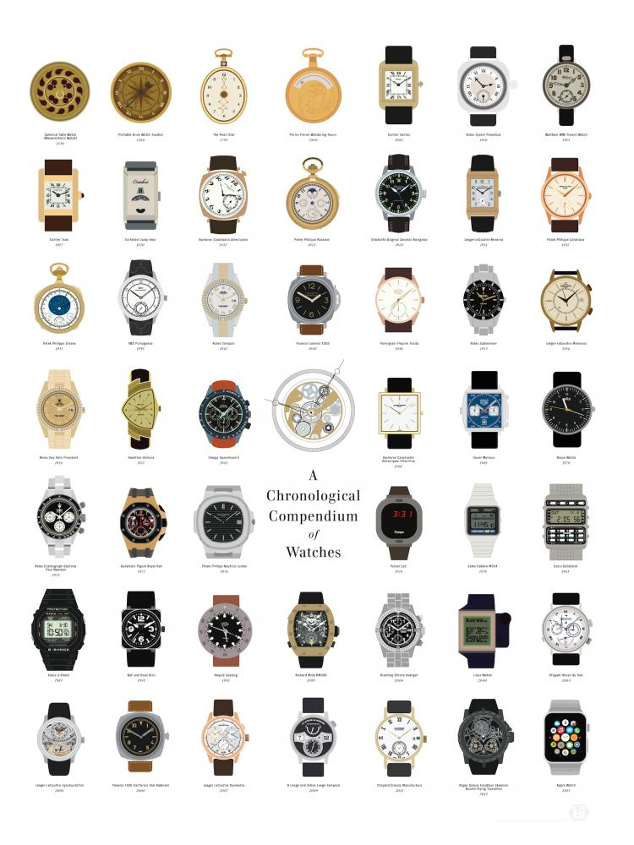
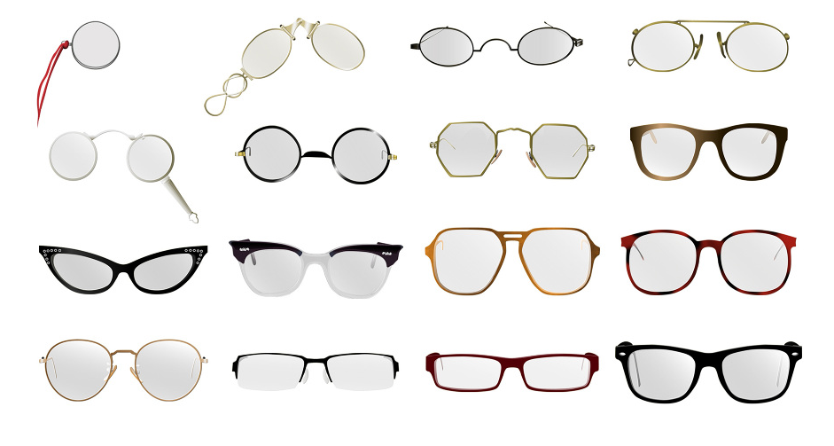
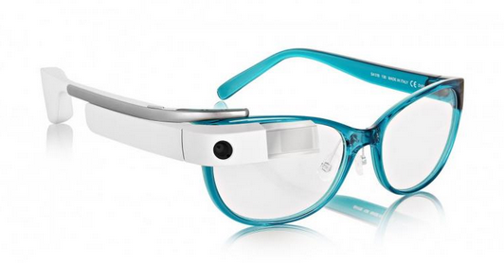
Notes:
Wearable technology –developed to improve our lives
Also a fashion statement
Who know what will happen to the google glass (or VR...)

Slide 5
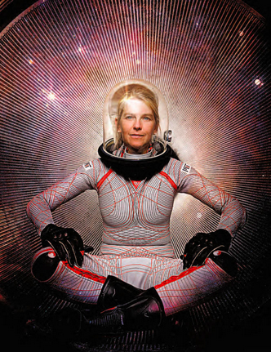
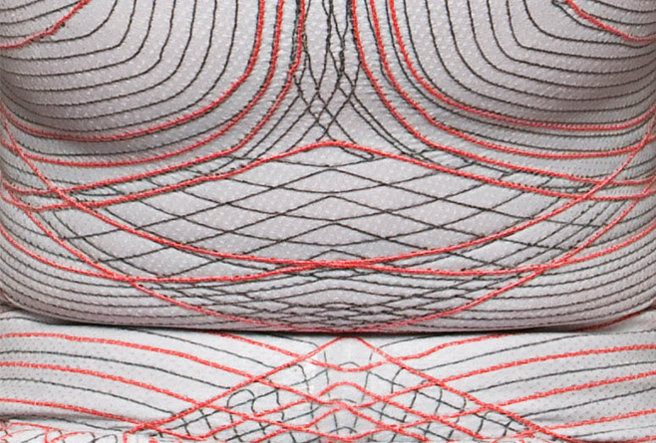
Development of materails by nasa and other places
Dava Newman, MIT
Notes:
What happens when you bring smart materials into the hands of creative inventors?
–developed by NASA in this case for pressure, and other industrial uses like shielding from Electromagnet Fields or packaging for electronic components.
This suit by Dava Newman, MIT

Slide 6
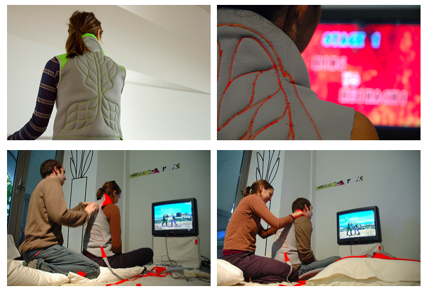
Project 1 massage hannahs
Massage Me by Kobakant, 2007 (http://www.massage-me.at)
Notes:
Community based open sourse practice
smart materials + Control +Sensors + human centered design
Massage me
Making of:
/?menu=1

Slide 7
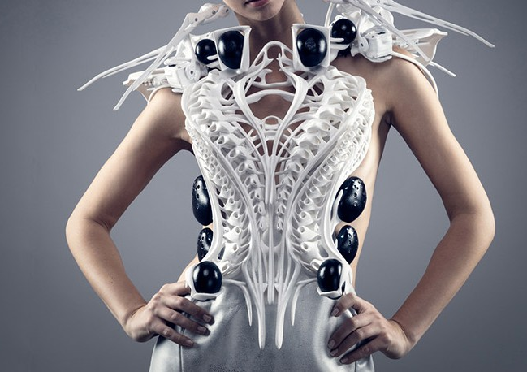
Spider Dress by Anouk Wipprech, ) 2014 (collaboration with Intel, see https://vimeo.com/114828162
Notes:
Anouk Wipprecht + spider dress –materials: 3d printed / mechanical system
Some very different contexts in which wearable technology is used

Slide 8
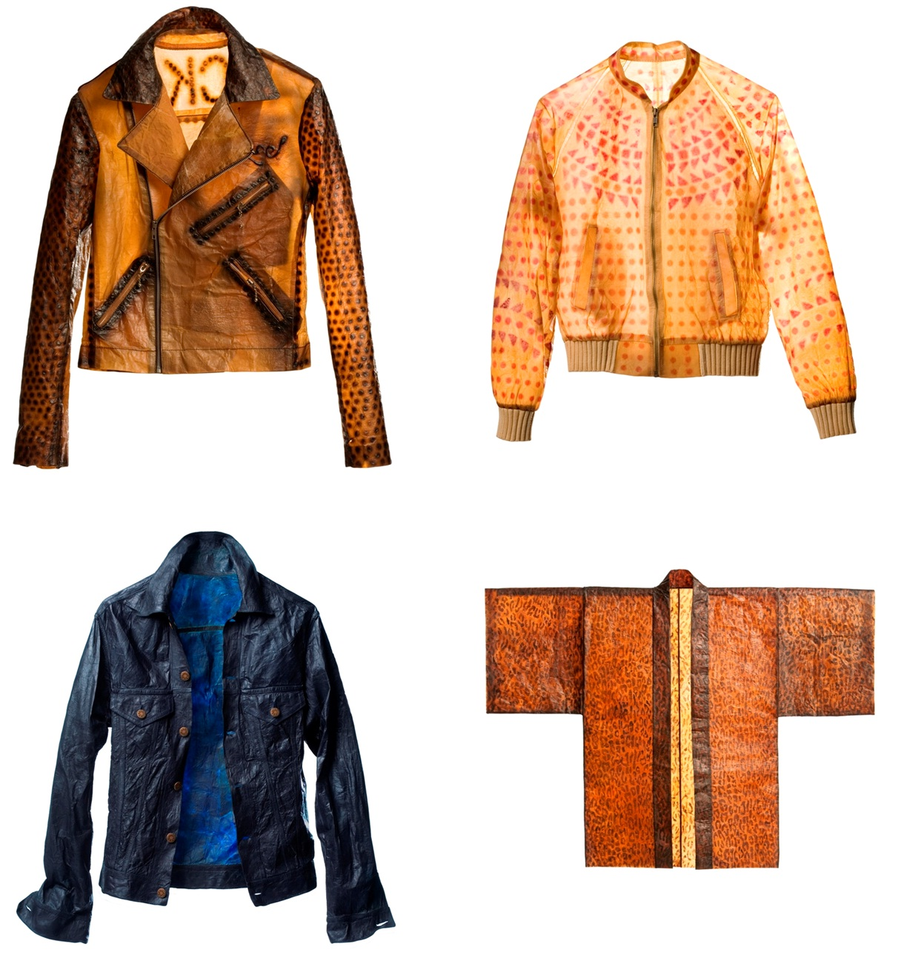
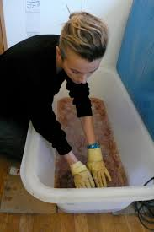
Grow your own clothes Suzanna Lee talk: https://www.ted.com/talks/suzanne_lee_grow_your_own_clothes?language=en

Slide 9
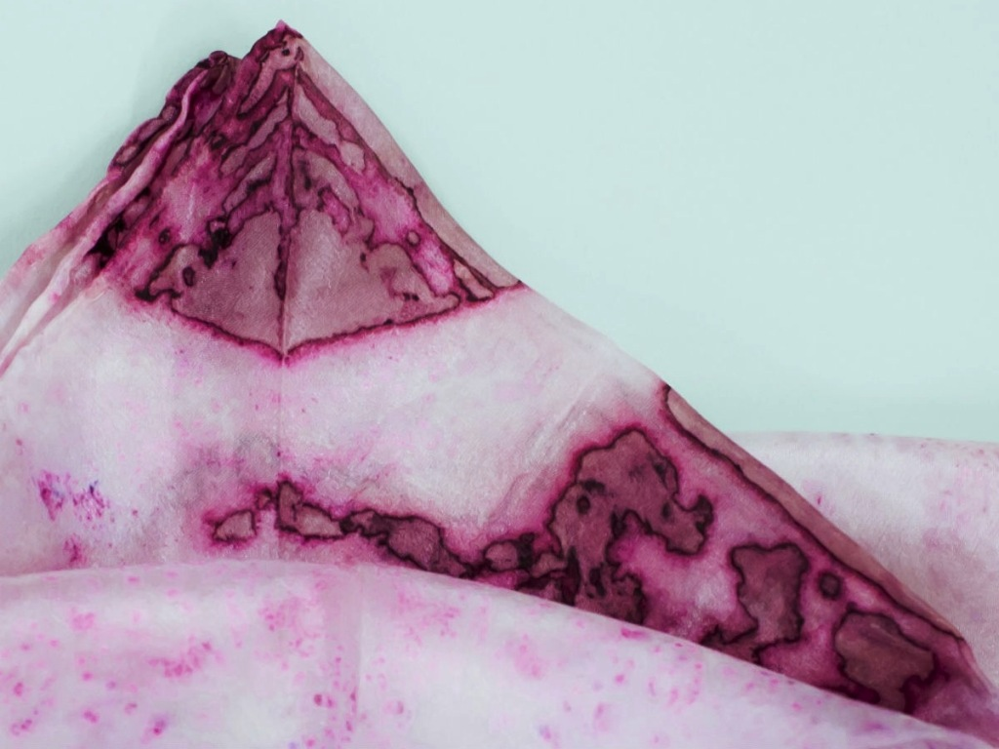
Natsai Audrey http://www.natsaiaudrey.co.uk/

Slide 10
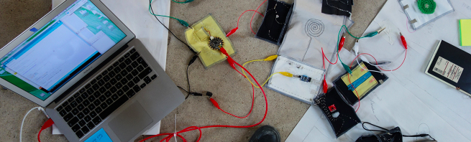
Human Breadboards Research
Questions: What do we learn when we are leaning with reference to people, the body, the space around us? How do you go beyond the swatch? How do you build wearable tech in to the curriculum in a meaningful and critical way? How to focus on process and learning, and not the product? http://blog.beccarose.co.uk/2015/09/08/human-breadboards/

Slide 11
"A boarder vision of technology education demands that socio-political, cultural and environmental facets of the 'multidiscipline' be integrated so that the subject is not simply focused on preparing future technologists but rather technology capable critical thinkers" Leo Elshof (2009). from Toward sustainable practices in technology education. International Journal of Technology and Design Education, 19(2), 133-147.
Notes:
Education for sustainable futures

Slide 12
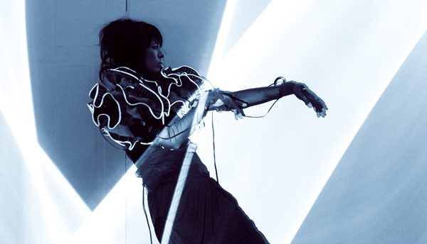
https://youtu.be/h4V8uklXCjg?t=5m34s (video in action)
Imogen Heap MiMu Gloves see: http://theglovesproject.com/
Notes:
Imogen Heap MiMu Gloves see: http://theglovesproject.com/
Redefining interactions + creative expression
Gestural feedback lots of scope + development in many fields

Slide 13
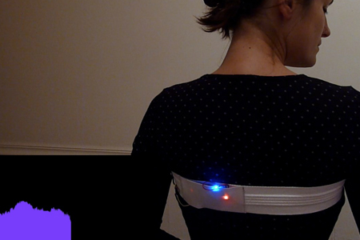
Drawing Breath See video: https://vimeo.com/119214347
Notes:
This is the bit where you show your work and samples

Slide 14
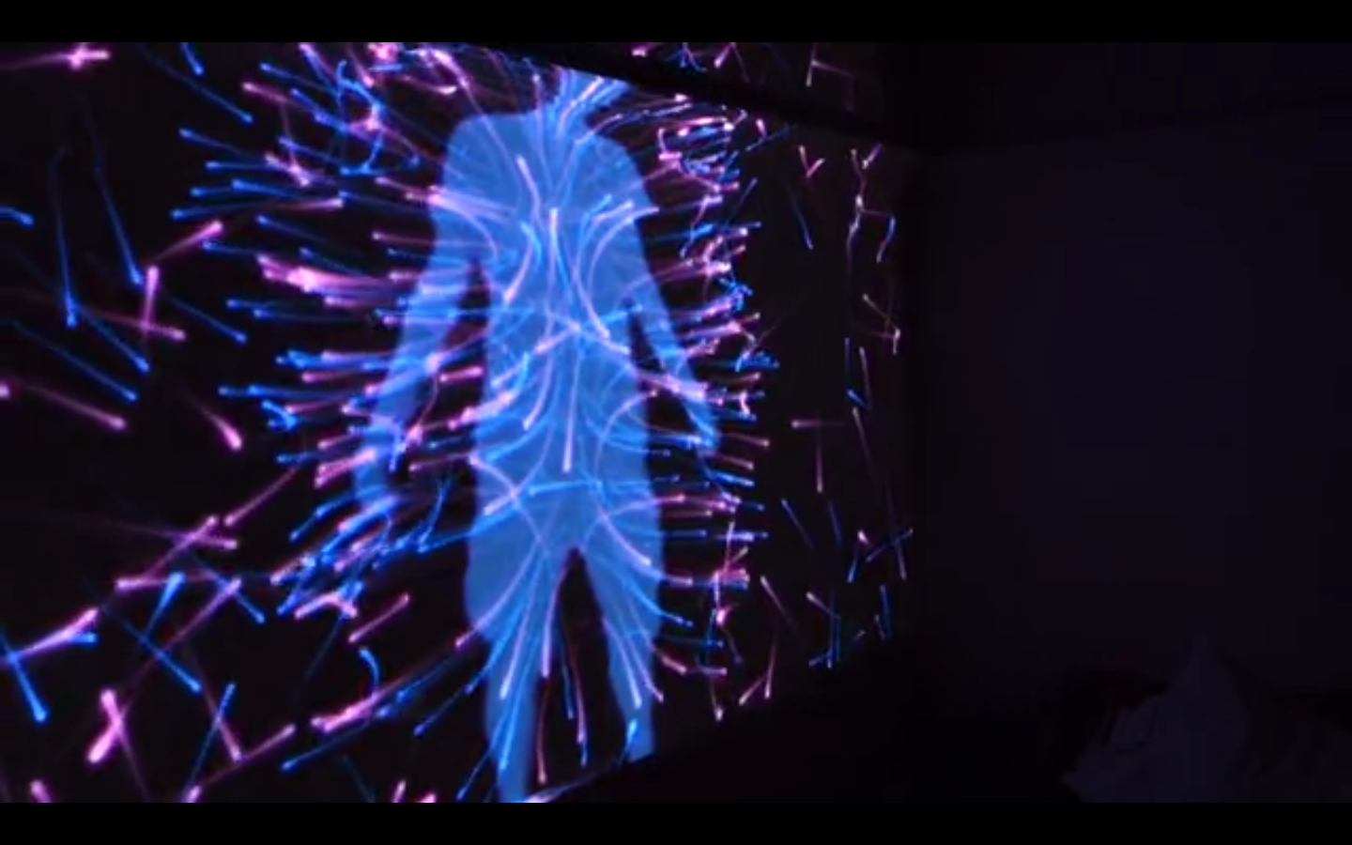
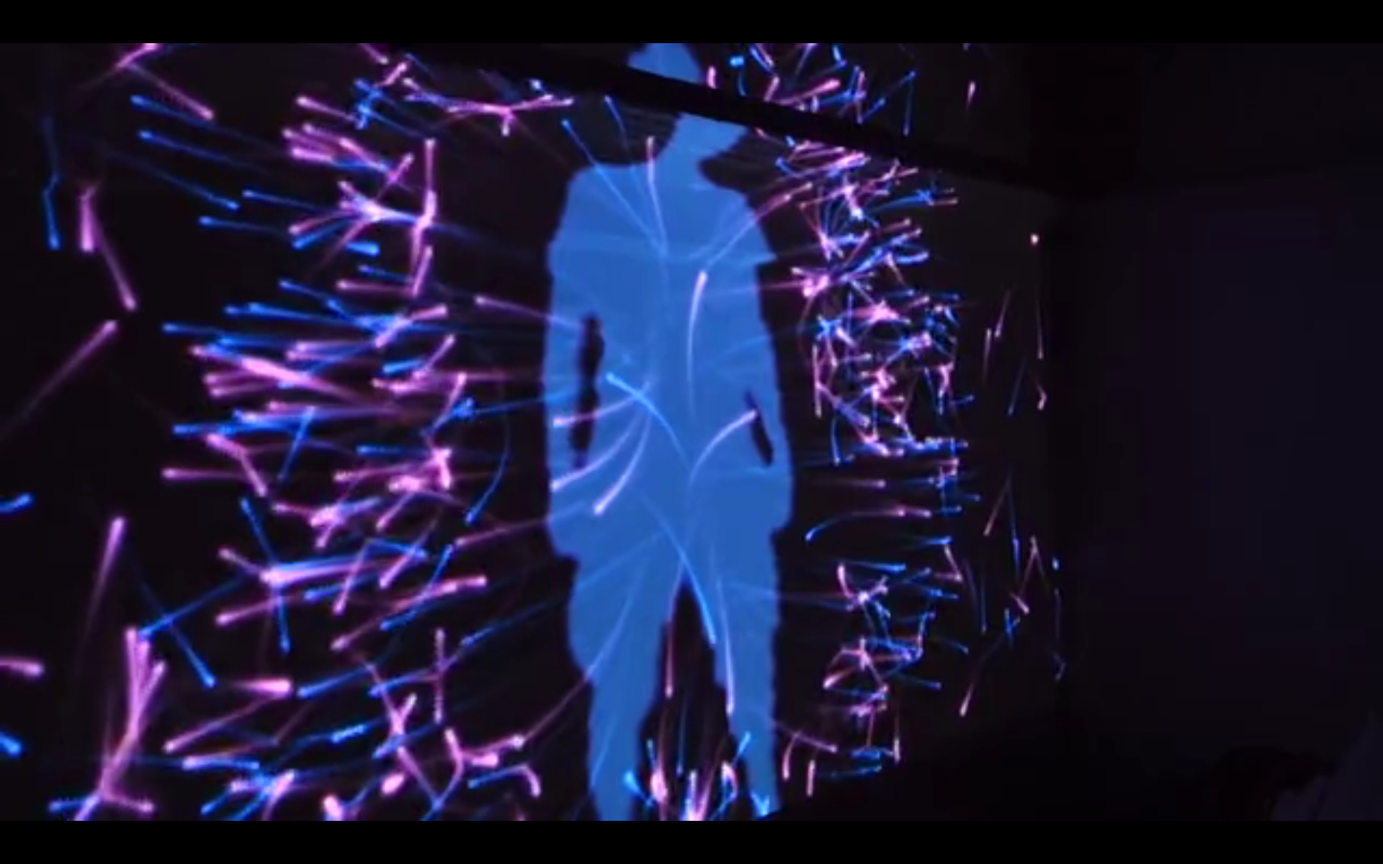
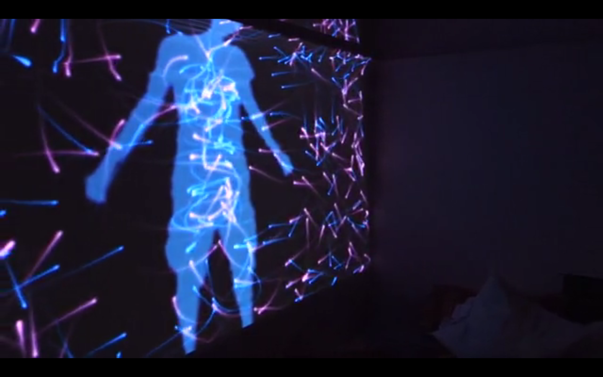
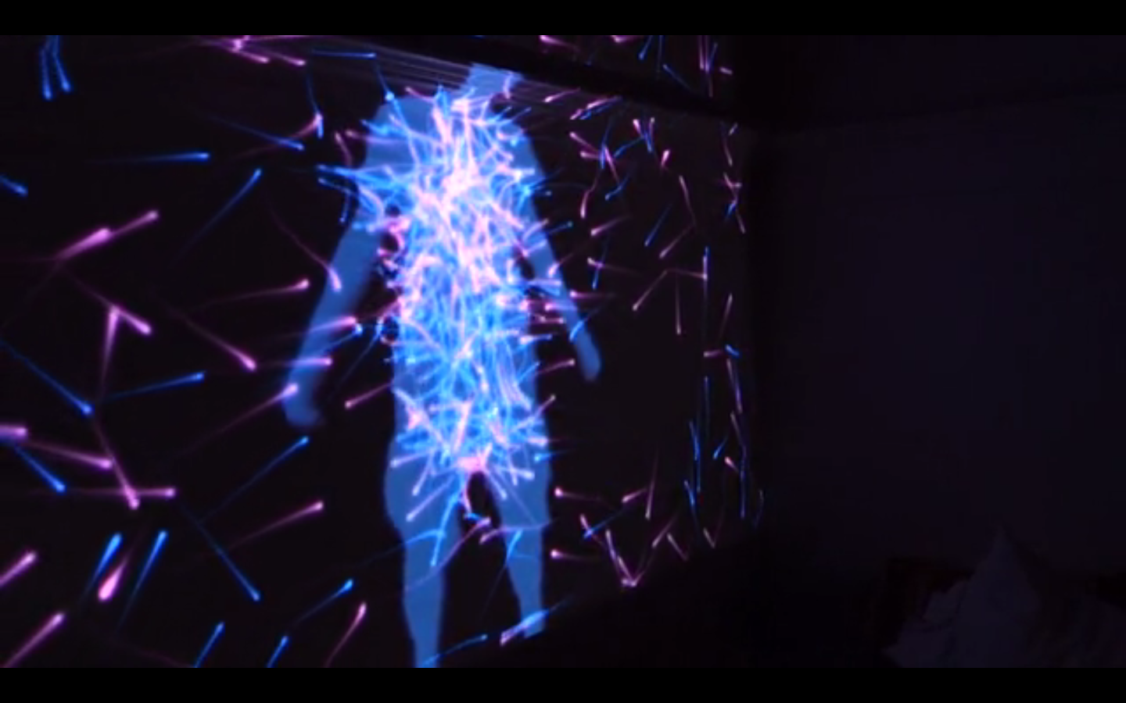
Notes:
Bio feedback –environmental + physical
-can we find new ways of connecting?
https://vimeo.com/119214347

Slide 15
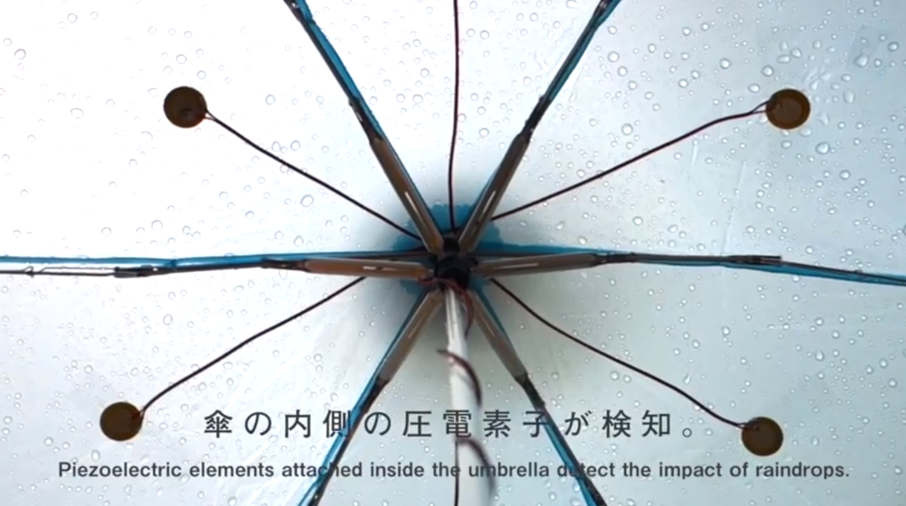
https://www.youtube.com/watch?v=AFpLCV_KDyQ
Rain Music!
Notes:
Fun Accessories!
https://www.youtube.com/watch?v=AFpLCV_KDyQ
Rain Music!

Slide 16
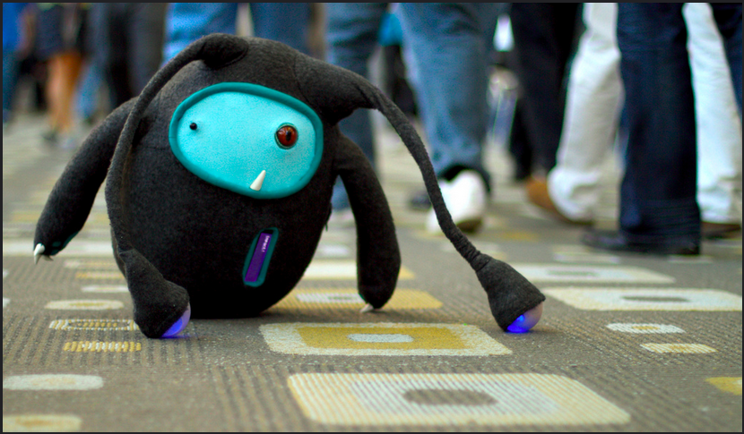
Tweeture
-making of http://pervasivemediacookbook.com/157/tweeture/
Notes:
Tweeture
-design collective in UK rusty squid, developing emotional AI, and looking at human social interaction with robotics, and how this is reflected in their representaion
-connecting people through the loveable object!
-wi-fi connected for as little as $19, a new field, less explored and more complications –social and logistical
“IoT” has a long way to go!
-making of http://pervasivemediacookbook.com/157/tweeture/

Slide 17
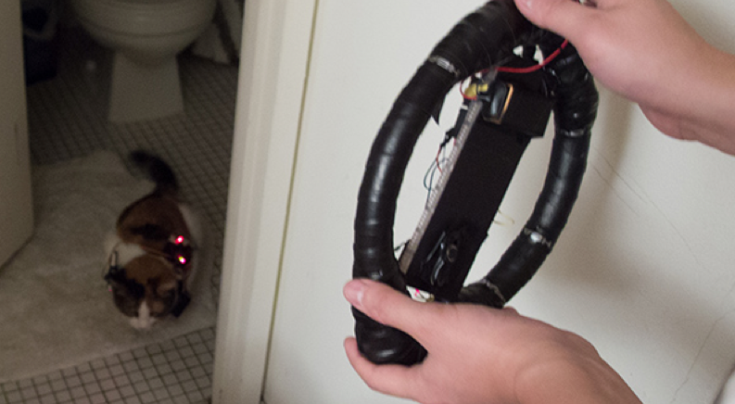
No animals were harmed in the making of this movie! https://vimeo.com/55880815 @1.03

Slide 18
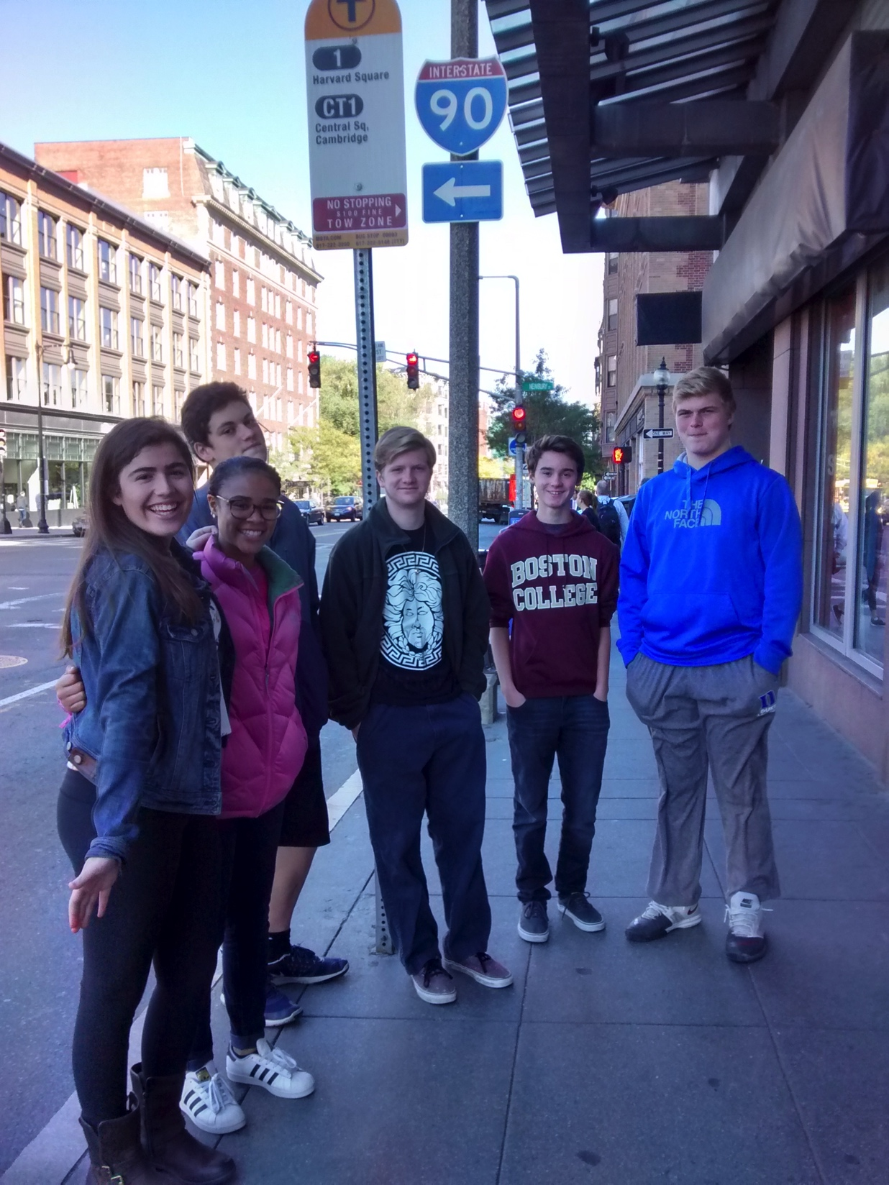
Interactive Bus: technology + storytelling NuVu, 2015

Slide 19
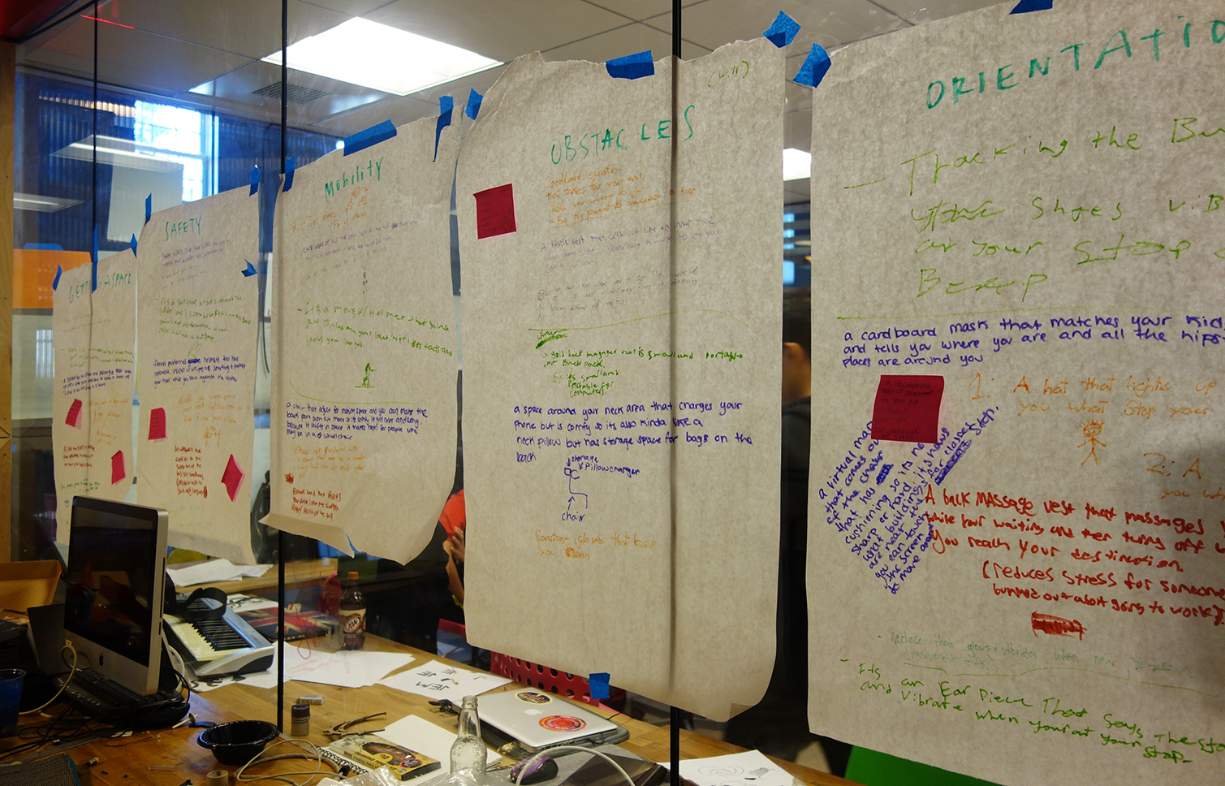
Initial Research Site visits, documentation, role play, photos, written response
Notes:
Interesting that this was the most fascinating of all the write ups they made –they really responded creatively to the experience.

Slide 20
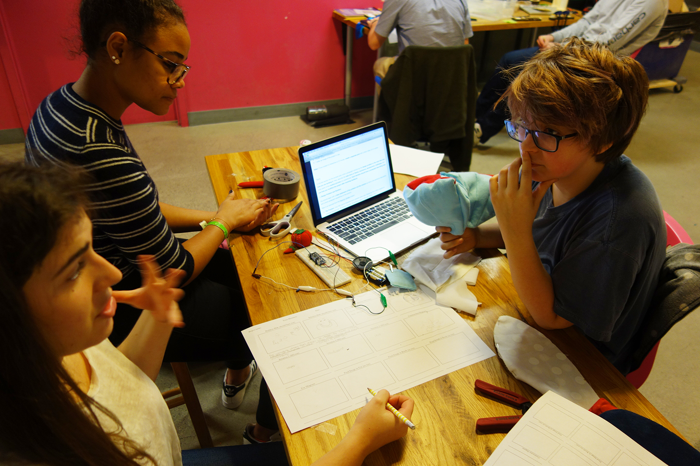
Development discussion, further research, rapid prototyping

Slide 21
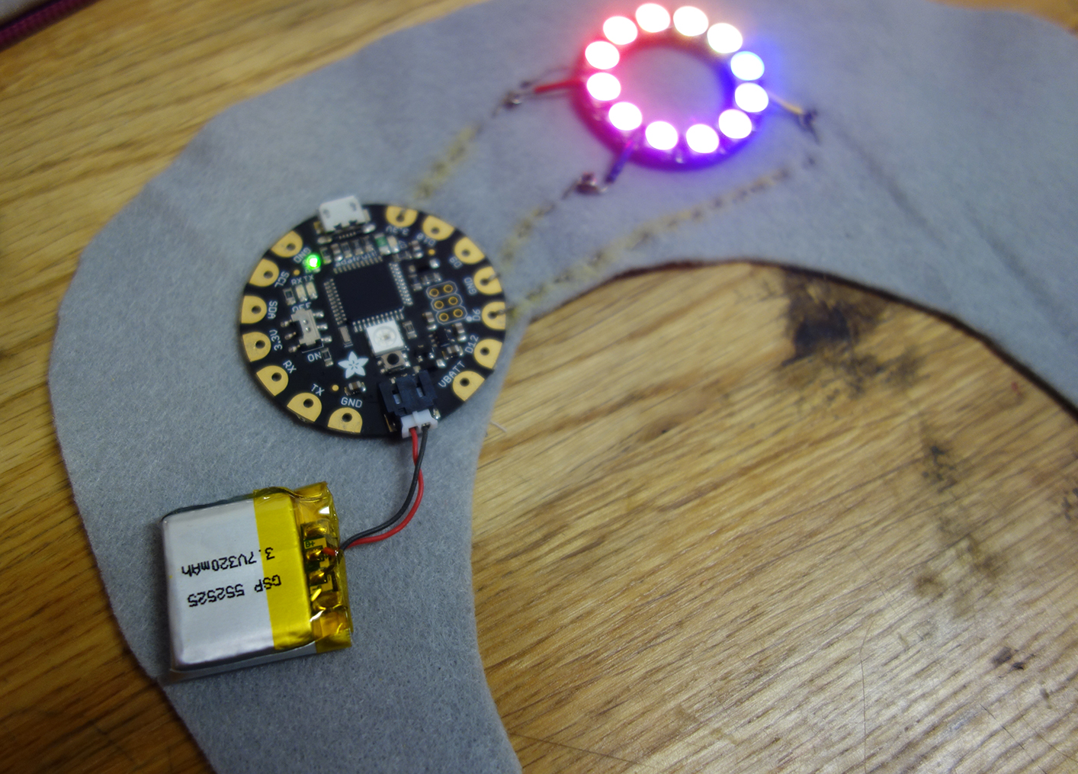
Prototype

Slide 22

Development

Slide 23
Using technology with social implications: empathy, technology for solving problems, and an active engagement with capability of technology (beyond consuming) What is more, it is student centred and exciting to learn! “normally in physics class I will do anything to avoid Arduino and all that technical stuff, but I would actually do it now that I know how to create something new” NuVu Student, 2015

Slide 24
In this session we will prototype an interactive wearable device
Notes:
Afternoon challenge
--prototype: does not need to be finished or working you are creating something that will express and idea
--we have a bunch of materials for making sketches, you can also add the circuits you made earlier
--we will work together at the start to generate some ideas, and then you will work in your groups to develop one of your ideas
--the purpose it to communicate your idea with the group
–we will have short presentations at the end of the session, these will be informal, and there will be a bit of guidance on this later.

Slide 25
Activity 1: quick thinking design challenge
Notes:
Area of interest i.e physical location, field you are interested in (not too obscure!)
Identify user group
3. Parts of the body 4. Emotion 5. Quality of Material (optional, may help with the design but can change) Quick thinking, make design, change.
Discussion Qs:
Did you go with a hunch (ideas you already had) or is this something new?
What was the most challenging part?

Slide 26
AREA OF BODY
Notes:
Do this in groups so that we have 4 of each 30 seconds of discussion time

Slide 27
AREA OF BODY
EXPERIENCE / INTEREST
Notes:
Something you do at the harbourside either with friends, family, school etc
i.e. getting the ferry

Slide 28
AREA OF BODY
EXPERIENCE / INTEREST
EMOTION
Notes:
Adjective –description of how people can feel

Slide 29
AREA OF BODY
EXPERIENCE / INTEREST
EMOTION
DEMOGRAPHIC
Notes:
I.e. young people, older people, families
WORKING INDIVIDUALLY
Everyone does all 4 on big sheet of paper with pens

Slide 30
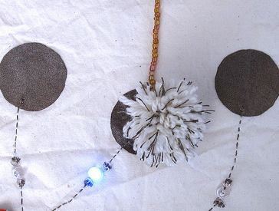
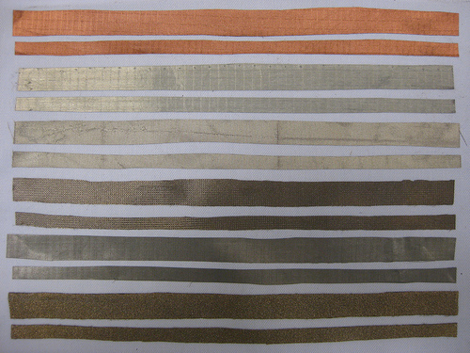
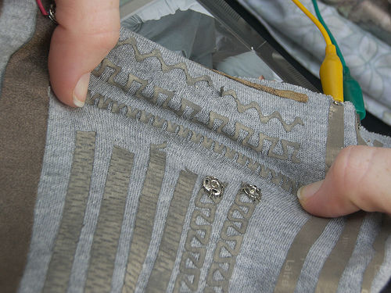
materials now accessible can be used by designers, makers and DIY level –not just in industry
Notes:
These materials now accessible can be used by designers, makers and DIY level –not just in industry

Slide 31
Activity 2: build circuits test materials sewing demo
Notes:
Circuit building: What is a circuit Actuators and sensors (Bare minimum) Material and example showcase.

Slide 32
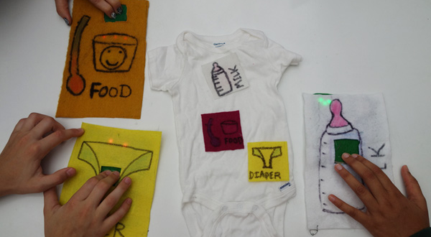
Communicational Onsie
Notes:
Show slides before circuit
Complex ideas (learning through visual / touch not just language
Social problem

Slide 33
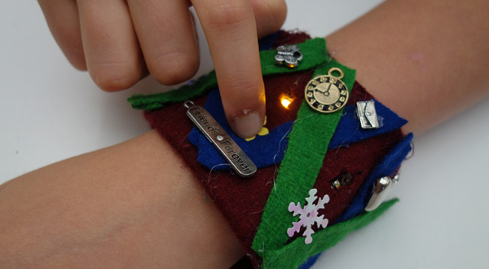
Friendship Memory Cuff
Notes:
Weakest group in terms of language –tutors were worried, short circuited and had to re-wire several times, but made a beautiful and interesting project
--complex circuit system

Slide 34
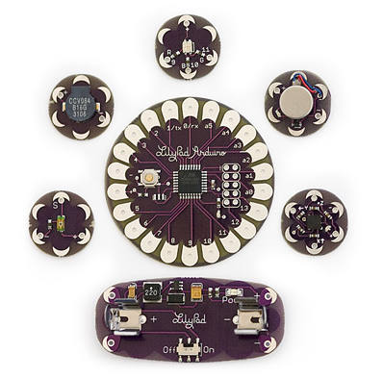
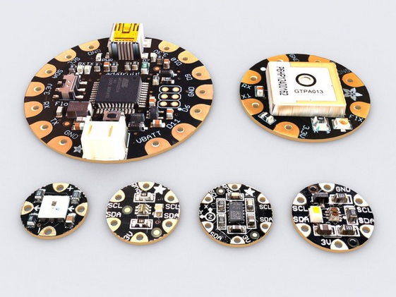
Programmers (which ones to choose?!)
Notes:
Other Technology that is available
Smart Materials combined with processing
–developments in microcontrollers like these to connect to materials
-main contenders = adafruit and lilypad both are arduino compatible
-SENSORS (on right –lilypad)

Slide 35
Activity 3: 3d sketching and rapid prototype flora / lilypad demo develop story-making and narrative present or perform
Notes:
Making Acticities Materials –SS Great Britian 3d sketching / rapid prototype story-making / narrative performance / roleplay / presentaion
IN GROUPS
Decide on one of your ideas
you will need to quickly develop an idea into a prototype that
communicates the essence of the idea
The ‘accessories/ embellishments’ will be presented during
the last 30 mins of the session, so you won’t have any time to waste.
Manage your time and expectations appropriately, and select materials that can
be worked quickly.
This is not an exercise in drawing. Discuss your thoughts and ideas, decide on a
direction and start making straight away.
Sketch in 3D, using materials that are easy to shape and manipulate. Establish
whether the idea works, and then refine it. If it doesn’t work, understand why
not, and adapt or revise the prototype accordingly until it does work.
Be prepared to give a short (1 min max) presentation & demonstration

Slide 36
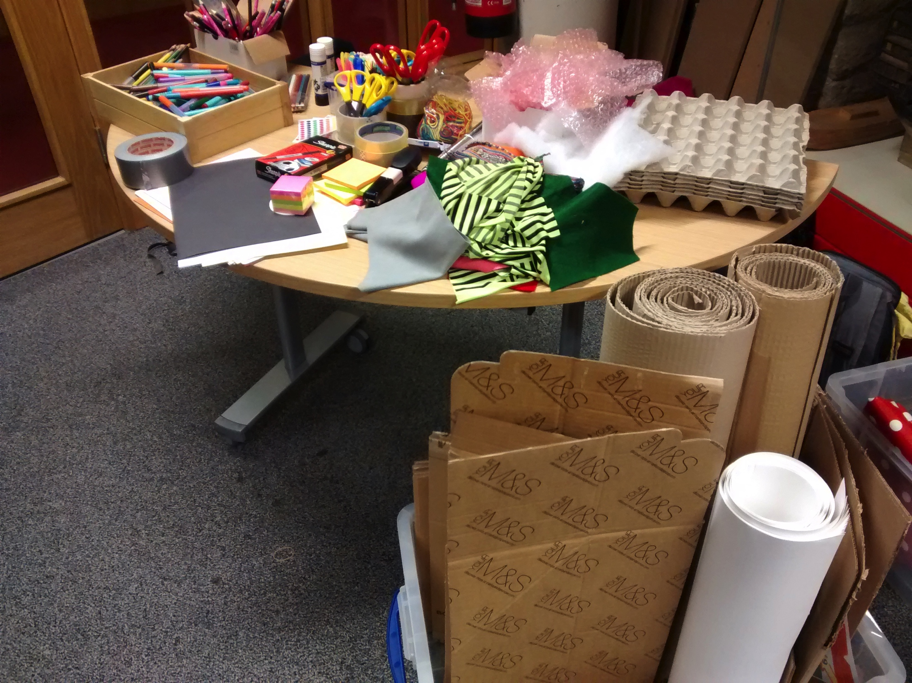

Slide 37
Where to buy these materials? Europe Kitronic Plug and Wear US Sparkfun -20% discount for educators Adafruit –good for etextiles (i.e. flora board, neopixels) LessEMF –conductive fabrics Jameco –conductive thead And amazon / ebay often have some materials

Slide 38
Links for making ideas
How to get what you want | http://www.kobakant.at/DIY
Conductive pom poms | http://www.instructables.com/id/Laser-Cut-Pom-Pom-Pressure-Sensors/
MIT high low tech | http://highlowtech.org/
What is an Arduino? | https://www.youtube.com/watch?v=pnf8ojsK6S4&feature=youtu.be
Makey Makey inspiration | https://docs.google.com/document/d/1_V5jCHmcdvQTC45uTBJtKna1rA9s2FYfT9zqgB_draY
Paper Circuit Materials list | https://docs.google.com/document/d/1FG8gmPqF3NS_vVanF4wa2y3CKUjLLqvlcKYemzPagnA/edit?usp=sharing
Sparkfun guide to paper circuits | https://learn.sparkfun.com/tutorials/the-great-big-guide-to-paper-circuits
Laser loom | http://www.thingiverse.com/thing:120555

